Slide 1
Dane County Broadband Task Force

Slide 2
Background
The Dane County Board of Supervisors approved 2020 RES-415 in mid-2020 that created the Dane County Broadband Task Force.
The 15-member task force was appointed shortly after with representatives from:
The Dane County Board
Healthcare provider
A school district in Dane County
An economic and/or agricultural perspective
A Town Board
Senior focal point
Internet/broadband service provider
Youth community-based organization
Community/General Public Members at large
Dane County Executive or designee
President of the Dane County Towns Association or designee
President of the Dane County Cities and Villages Association or their designee

Slide 3
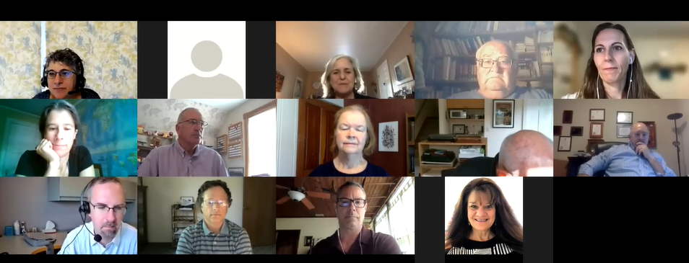
Membership
•Andrew Hoyos
•Bill Dickmeyer
•Bob Wipperfurth
•Cathy Sutter
•Dave Ripp
•Deana Zentner
•James Danky
•Joyce Tikalsky
•Kate McGinnity
•Melissa Ratcliff
•Michelle Jensen
•Peter Weil
•Renee Lauber
•Sarah Ghee
•Todd Violante

Slide 4
Goals
• Create a greater community understanding of Dane County’s challenges related to high-speed, reliable and affordable internet access for the County as a whole
• Prepare local partners in Dane County to have the background and knowledge (e.g. accurate maps, data on speeds, access, etc.) to apply for various grants and funding to expand access to unserved and underserved areas of the county
• Increase awareness of the issues those without reliable internet access face

Slide 5
Purpose
Understanding the complexities of broadband access as it relates to improving access to those unserved and underserved in Dane County;
Collecting data points on underserved and vulnerable populations to determine if there is a greater percentage impacted by lack of access to reliable and affordable broadband than indicated by the maps
Understanding the various funding mechanisms used for improving broadband access, to include state and federal grants, with the intention of identifying strategies, partners, and potential funding sources that will support the expansion of broadband services;

Slide 6
Purpose
Partnering with various stakeholders to identify where access to broadband is and is not available;
Exploring alternative solutions to inadequate broadband service including but not limited to hot spots, satellite technology, and wireless service;
Making recommendations to the County Board on the role of Dane County in facilitating the expansion of broadband services to residents; and
Holding two public hearings to hear from local officials and residents about challenges related to broadband.

Slide 7
Speed test data points map from MadRep
https://expressoptimizer.net/public/publicreport.php?state=Wisconsin&type=county&name=Dane%20County

Slide 8
Timeline
July 2020 – First Meeting
November 2020 – Budget amendment approved to pilot conduit placement in county highway projects
March 2022 – Survey roll-out
May 2022 – Receive survey results
June 2022 – Provide recommendations to County Board

Slide 9
Presentations the Task Force has Received
County Authority and Funding Possibilities
Map Coverage and Surveys
Grant Funding Opportunities and Requirements
Presentations on Grant Requirements
Town of Vermont community champion
Presentation on MadRep speed test/mapping effort and technology options
Middle Mile Overview

Slide 10
Outreach
Survey – Will be mailed to a sample initially, with a subsequent online collector for additional participation
MadRep Speed Test
http://madisonregion.org/industry-and-innovation/broadband/
Broadband Task Force website
https://board.countyofdane.com/initiatives/Broadband-Task-Force
Social Media
Press Releases
Public hearings – Dates to be determined

Slide 11
Meetings
Dane County Broadband Task Force meetings take place the first Thursday of the month at 9:00am.
Agendas can be found here:
https://dane.legistar.com/Calendar.aspx
Until further notice, meetings are held virtually
Comments can be sent to staff to be forwarded to task force members. Email: kuhl.lauren@countyofdane.com

Slide 12
Questions?
Contact:
County Board Supervisor Melissa Ratcliff – District 36
Chair of Task Force
Ratcliff.Melissa@countyofdane.com
County Board Supervisor Kate McGinnity – District 37
Vice-Chair of Task Force
McGinnity.Kate@countyofdane.com

