Slide 1
Rural Preservation Forum
Presenters:
Jim Welsh, Executive Director of Groundswell Conservancy
Renée Lauber, DCTA Policy Advisor

Slide 2
Outline for Forum
Big Picture – ag land protection across the country and in WI
Why do it?
How it works
Town Role
Discussion

Slide 3
Purchase of Agricultural Conservation Easement programs operate in 32 states
Source: Farmland Information Center 2015 PACE Survey – www.farmlandinfo.org
Notes:
Purchase of agricultural conservation easement (PACE) programs use public funds to compensate property owners for keeping their land available for agriculture. PACE is known as Purchase of Development Rights (PDR) in some locations.
As of January 2015, at least 28 states have state-level PACE programs. Of these, 16 also have local PACE programs. Four additional states (Illinois, Minnesota, Montana and Oregon) only have PACE programs at the local level. This activity is depicted in the PACE map. Montana’s state PACE authority expired in 2003. Its previous activity appears on the state PACE table. Three more states (Arizona, Georgia and Missouri) have authorized programs but have not yet purchased agricultural conservation easements.
PACE data are from the Farmland Information Center 2015 PACE survey, which tracks activity in calendar year 2014.

Slide 4
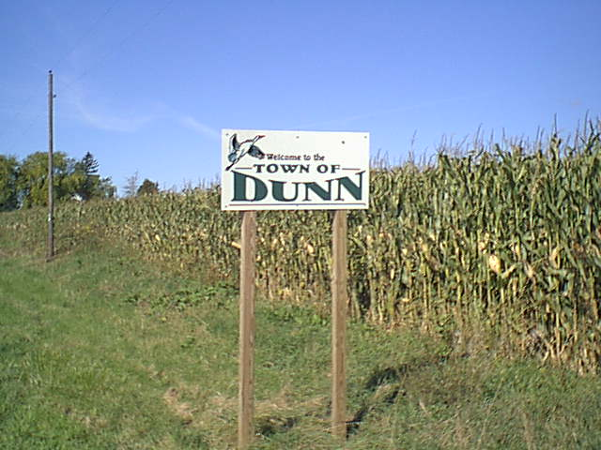
Wisconsin Programs
Sauk County
Rock County
Jefferson County
Town of Bayfield, Bayfield Co.
Town of Dunn, Dane Co.
Town (Village) of Windsor, Dane Co.
Town of Dunkirk, Dane Co, working toward a program

Slide 5
Why do it?

Slide 6
Why Protect Farmland?
Farmland is a rapidly disappearing resource.
According to the American Farmland Trust, the United States is losing forty acres of farm and ranch land every hour to new development. Between 1982 and 2010, America has converted 24 million acres of agricultural land to developed uses. This is roughly the size of Indiana and Rhode Island combined.

Slide 9
Madison grew more than any other city in the state from 2015 to 2016

Slide 12
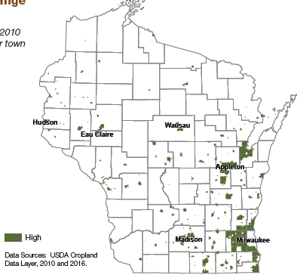
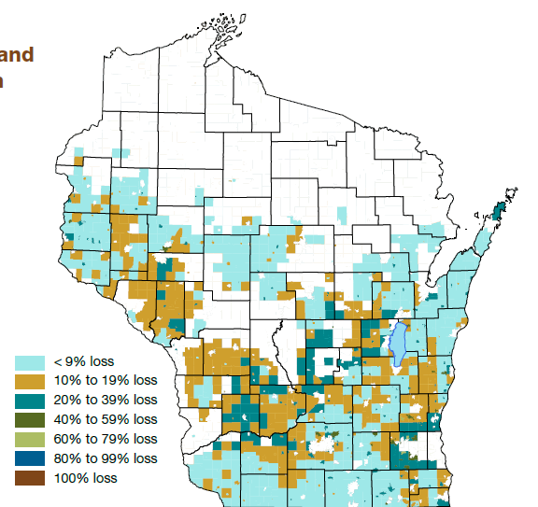
Changes between 2010 and 2016
Rate of development
Crop and pasture loss

Slide 14
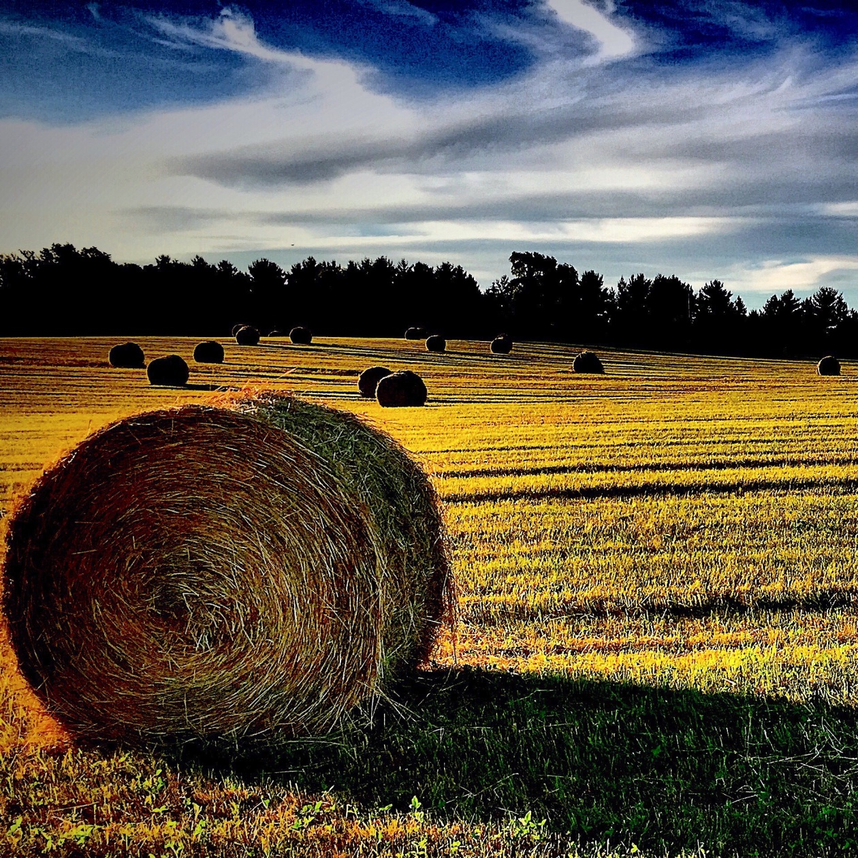
2,750 Dane County Farms (2012)
Total acres: 504,420
Average size: 183 acres
Median size: 68

Slide 15
Agriculture is very important to Dane County
• $3.4 billion in economic activity
• Every $1 of sales from agricultural products generates an additional $.55 of economic activity in other parts of the county’s economy
• Provides 17,294 jobs for Dane County Residents
Alison Volk, DATCP and UW Extension’s 2014 Dane County Agriculture: Value & Economic Impact bulletin

Slide 16
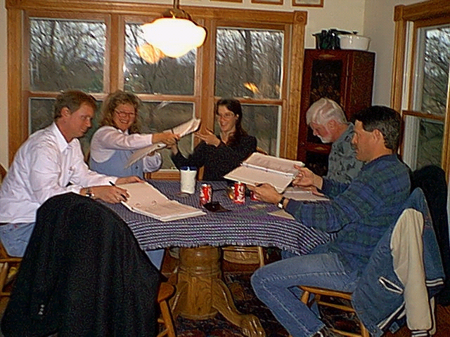
Why Protect Farmland?
Land Ethic
Want to keep enough fertile land available for farming so we don't risk becoming dependent on other nations to feed our growing population.

Slide 17
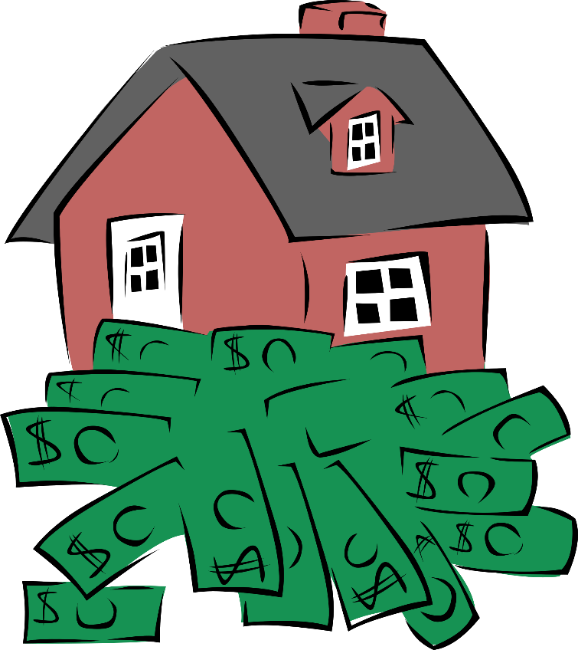
Why Protect Farmland?
Business decision
Liquidate capital without having to sell land
Donation can be significant tax deduction
Estate Planning
Divide assets
Reduce estate tax

Slide 18
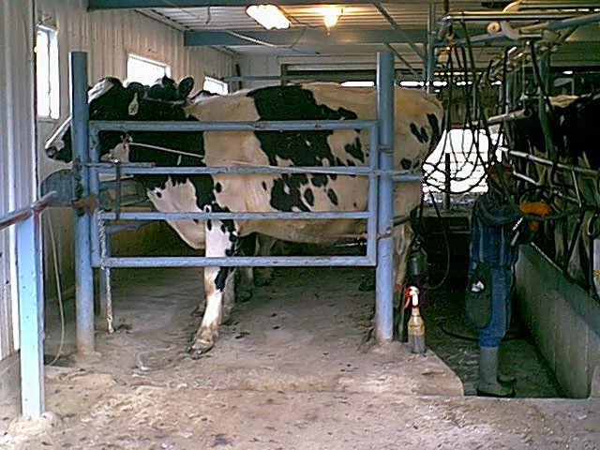
Why Protect Farmland?
Encourages farmers and ag business to reinvest in operations
Keeps land affordable for other famers, including heirs
Voluntary, non-regulatory
Compensates landowners
Permanent protection

Slide 19
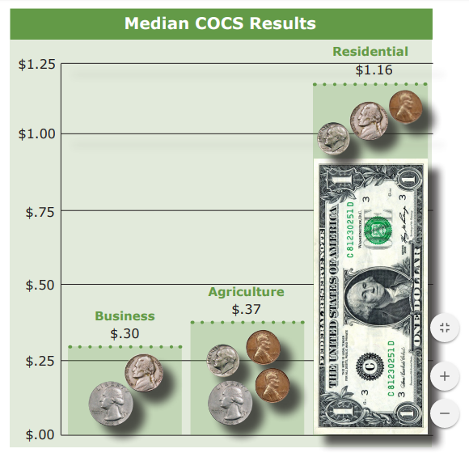
American Farmland Trust developed COCS studies in the mid-1980s to provide communities with a straightforward and inexpensive way to measure the contribution of agricultural lands to the local tax base.
Data from 151 studies in communities in the US
Source: Cost of Community Services Studies, Farmland Information Center, American Farmland Trust, 2016.

Slide 20
How it works

Slide 21
How it works
Land protection is done through Conservation Easements that are either purchased or donated or portions of both

Slide 22
Basic Concepts
A “Conservation Easement” is a legal document used to record the permanent land use restrictions
“Development Rights” are a landowners rights to develop, or subdivide, his or her land.

Slide 23
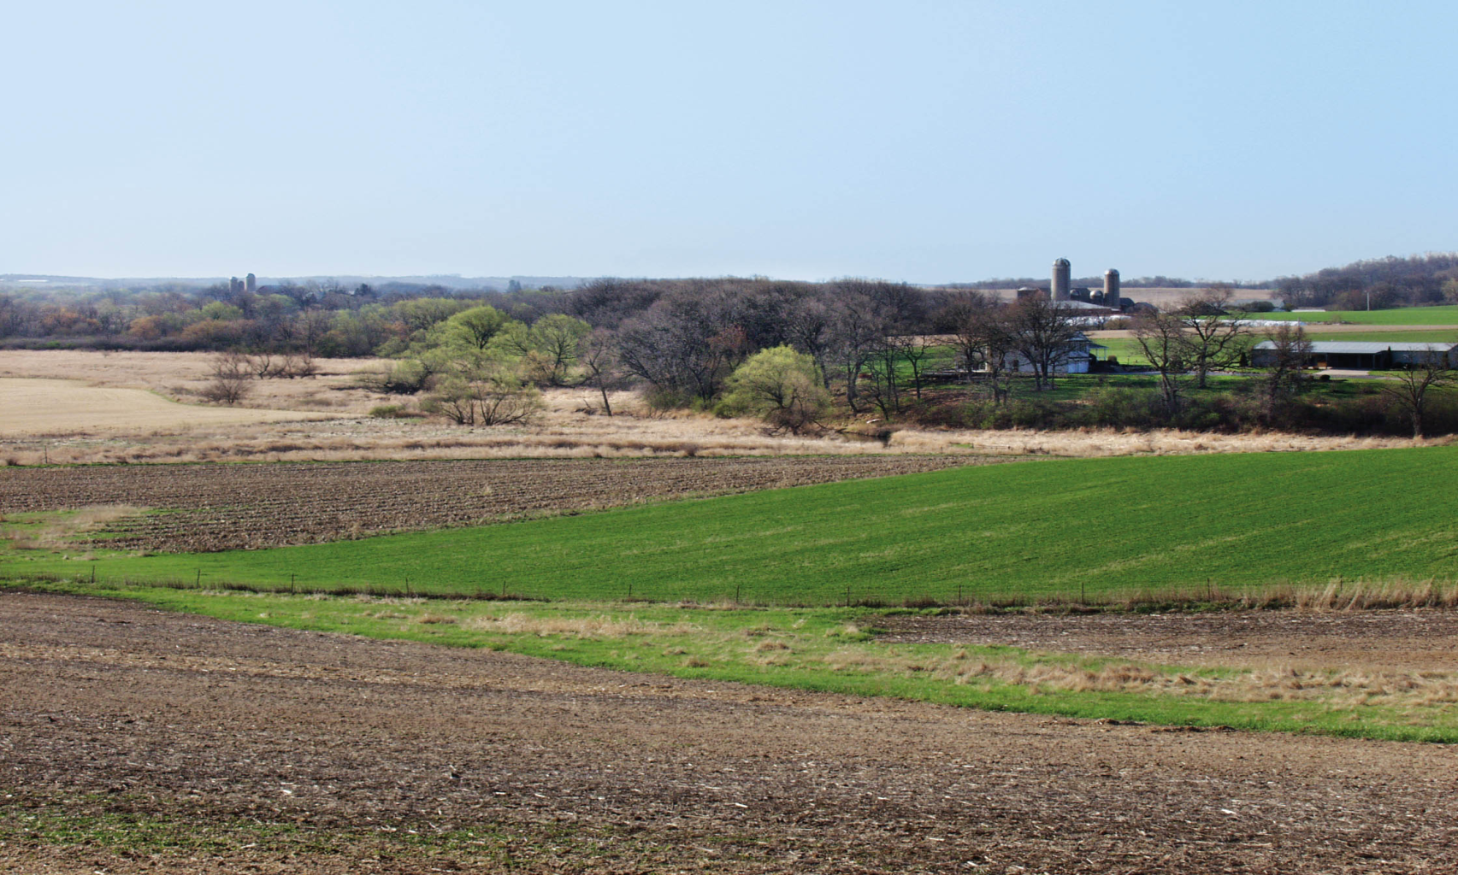
Control access
Sell timber
Build
houses
Hunt
Rent
cropland
Oil/Gas
Billboards
Rights of Ownership

Slide 24
Landowner:
Easement Holder:
Control access
Sell timber
Build
houses
Hunt
Oil/Gas
Rent
cropland
Billboards
Rights of Ownership

Slide 25
Basic Concepts
Voluntary program that buys “development rights” from landowners.
Land remains in private ownership and the landowner retains all other rights and responsibilities associated with being a property owner.

Slide 26
Basic Concepts
No public access required for farm protected by conservation easement.
Permanent land use decision

Slide 27
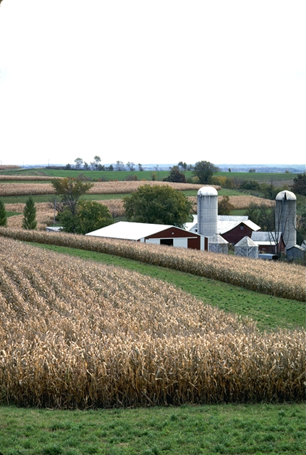
How does a program work?
Sale of Development Rights is recorded in an easement document
Land can be sold or passed on to heirs
Easement is tailored to each property
-Can retain building sites or splits
-Allow for farm expansion

Slide 28
Typical Easement
Are all conservation easements the same?
No. General restrictions in most easements prohibit using land in a way that makes it unavailable for agriculture.
The exact terms of each agreement, are negotiated between the parties involved.

Slide 29
Valuing Easements
Value varies with each property and easement restrictions
An appraisal determines the value
Landowners are encouraged to get their own appraisal
Development Value | - | Ag. Land Value | = | Easement Value

Slide 30
Funding to purchase easements
USDA NRCA – focuses on high-quality soil
State program -- lapsed
Local funding

Slide 31
Tax incentive for donated easement
Federal tax deduction
For full or partial donation of conservation easement value
Deduction of up to 50% of adjusted gross income (for up to 15 years)
A Farmer can deduct up to 100% of adjusted gross income (for up to 15 years)

Slide 32
What are the downsides?
Buying development rights is expensive
Transactions are time consuming
Works where you can protect a “critical mass” or large blocks of land
Requires future monitoring and enforcement

Slide 33
Common misconceptions
I will not be able to give the land to my children.
Land is still owned by the landowner and can be sold just as any other property.
I will not be able to build a house for my children.
The scope of future development is the choice of the landowner who puts the conservation easement on his/her farm.

Slide 34
Common misconceptions
I don’t want to allow public access on to my land.
The town is not interested in providing public access.
I will not be able to get a bank loan.
Conservation easements reduce the value of the property, so the size of a loan available can be reduced. Many landowners use funds to pay down loans.

Slide 35
Common misconceptions
I have to include all of my land.
Easements can be done on a portions of a property.

Slide 36
How Does PDR Benefit Town Residents?
PDR permanently protects vulnerable lands and important resources.
PDR retains scenic views of open space, natural areas and farmland.
PDR preserves the quality of life and rural character of the town.
PDR reduces the growth of property taxes for public services needed for residential development.
Land stays on property tax rolls.

Slide 37
How Does PDR Benefit Landowners?
PDR is voluntary and retains property in private ownership.
PDR compensates landowners for the development value of their property.
PDR can be tailored to an individual landowner’s needs.
PDR makes it financially feasible to keep farming by providing cash assets for estate planning, retiring debt and farm improvements.
PDR keeps farmland affordable for new farmers and for farmers who want to expand their operations.

Slide 38
Town Role
Planning
Consistent with local plans
A rural preservation program needs to be part of your Comprehensive Plan

Slide 39
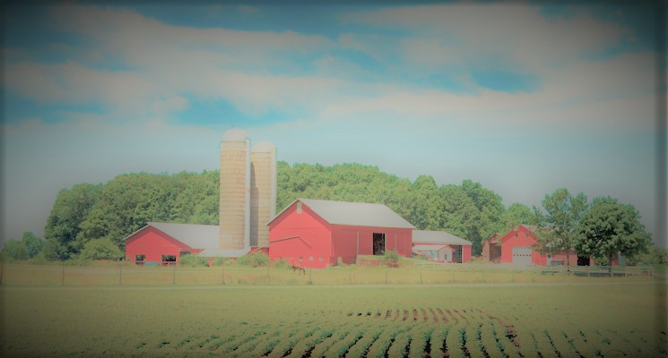
Thank you for attending.

